Slide 1

Introduction to Big Data Analytics (BCSE0157)
Credit: 03
Dr. Robin Singh Bhadoria,
Associate Professor, Dept. of CEA

Slide 2
Books & Important Links
Text Book: Seema Acharya and Subhashini Chellappan, “Big Data and Analytics”, 1st Edition, 2015, Wiley, India.
Links:
W3Schools
(https://www.w3schools.in/hadoop-tutorial/what-is-big-data/)
Tutorial Points (https://www.tutorialspoint.com/big_data_analytics/index.htm)

Slide 3
What is Big Data ?
“Big data is a term applied to data sets whose size or type is beyond the ability of traditional relational databases to capture, manage and process the data with low latency.”…..IBM Corporation
“Big data is the term for a collection of data sets so large and complex that it becomes difficult to process using on-hand database management tools or traditional data processing applications.”…..Wikipedia

Slide 4

Concept & Evolution of Big Data
The term big data has been in use since the 1990s, with some giving credit to Dr. John Mashey from Pennsylvania State University, USA. for popularizing the term.
Around 2005, people began to realize just how much data, users generated through Facebook, YouTube, and other online services.
Hadoop (an open-source framework created specifically to store and analyze big data sets) was developed that same year. NoSQL also began to gain popularity during this time.

Slide 5
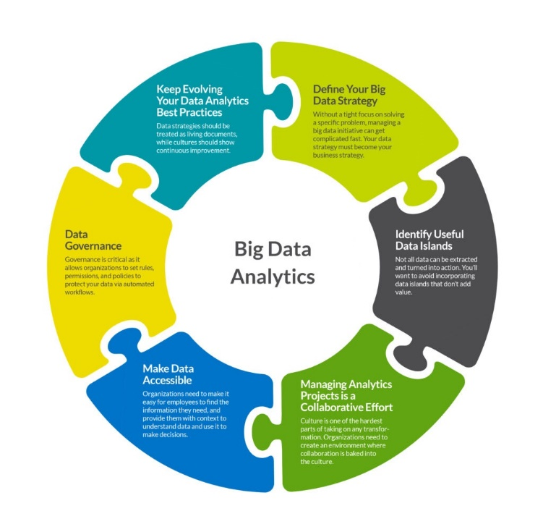

Slide 6
Types of Digital Data
There are three types of digital data.
1) Structured Data:- It has been organized into specific format that is typically database. e.g. Relational database.
2) Un-Structured Data:- Un-structured data is data which is not organized in specific manner or format. e.g. Audio, Video, PDF, Media
3) Semi-Structured Data:- It does not stored in relational database but that have some organizational properties. e.g. XML data, Emails.

Slide 7
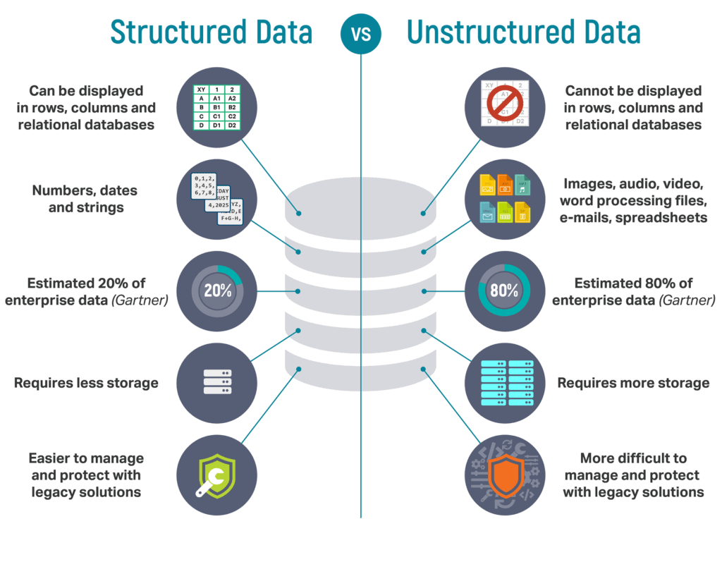

Slide 8
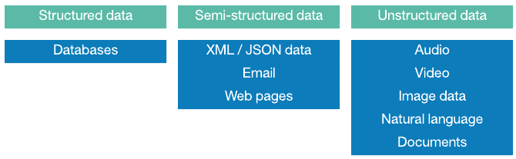
Examples

Slide 9
Importance of Big Data
Reduction in cost.
Time reductions.
Well-groomed decision making.
Real-time determination of core causes of failures, problems, or faults.
Risk-management can be done in minutes by calculating risk portfolios.

Slide 10
Big Data Analytics
Big Data analytics is a process used to extract meaningful insights, such as hidden patterns, unknown correlations, market trends, and customer preferences.
Benefits:
Risk Management
Product Development and Innovations
Quicker and Better Decision Making Within Organizations
Improve Customer Experience

Slide 11
Characteristics of Big Data: 5V’s
The primary characteristics of Big Data are:
Volume
Velocity
Variety
Veracity
Value

Slide 12
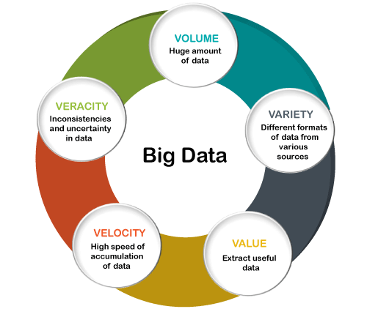

Slide 13
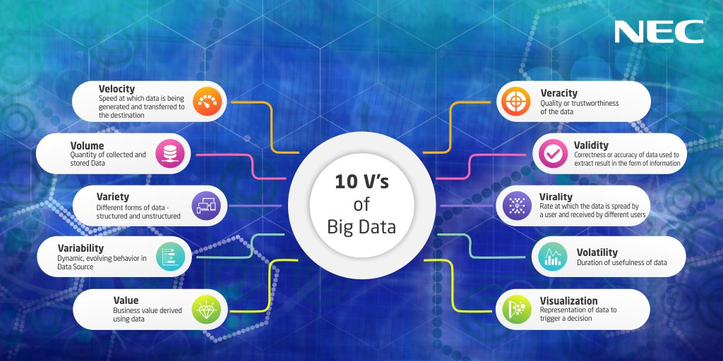
10V’s of Big Data

Slide 14
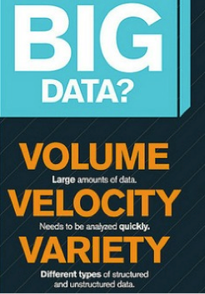

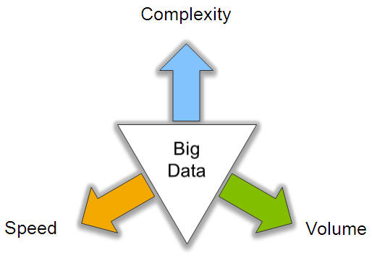
Characteristics of Big Data

Slide 15
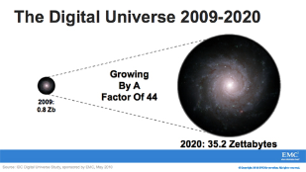
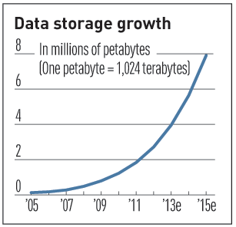

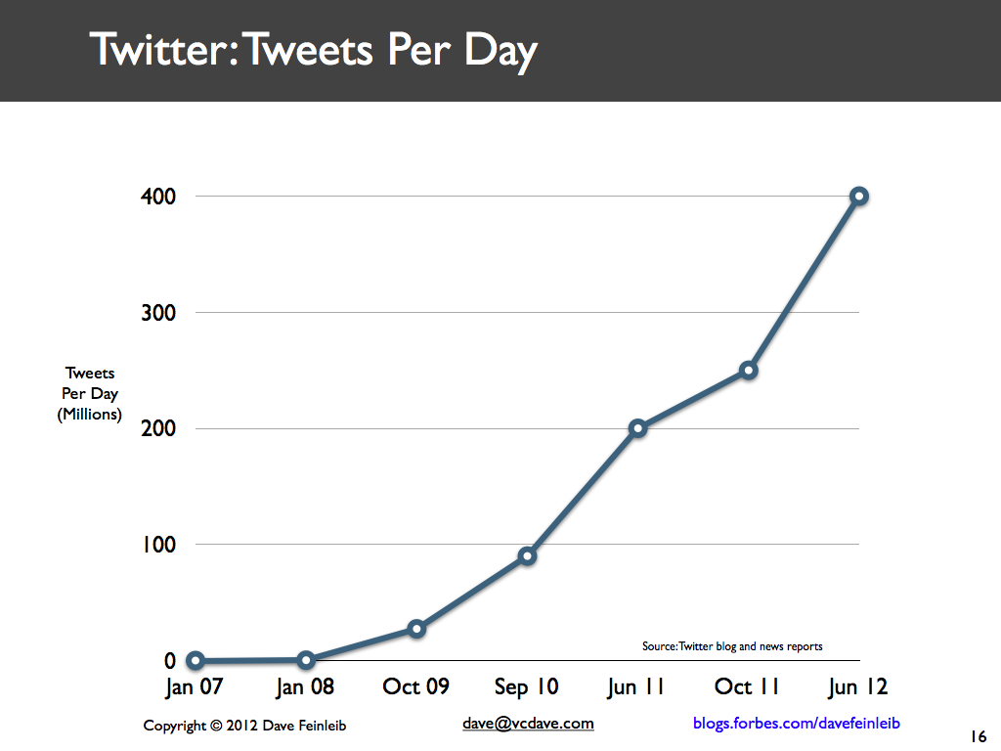
Volume (Scale)
Data Volume
44x increase from 2009 2020
From 0.8 zettabytes to 35zb
Data volume is increasing exponentially
Exponential increase in collected/generated data

Slide 16
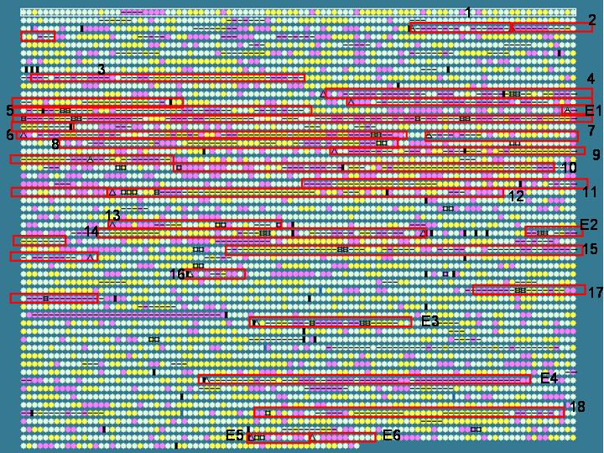

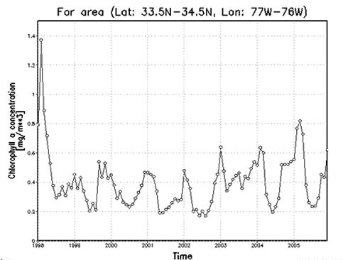

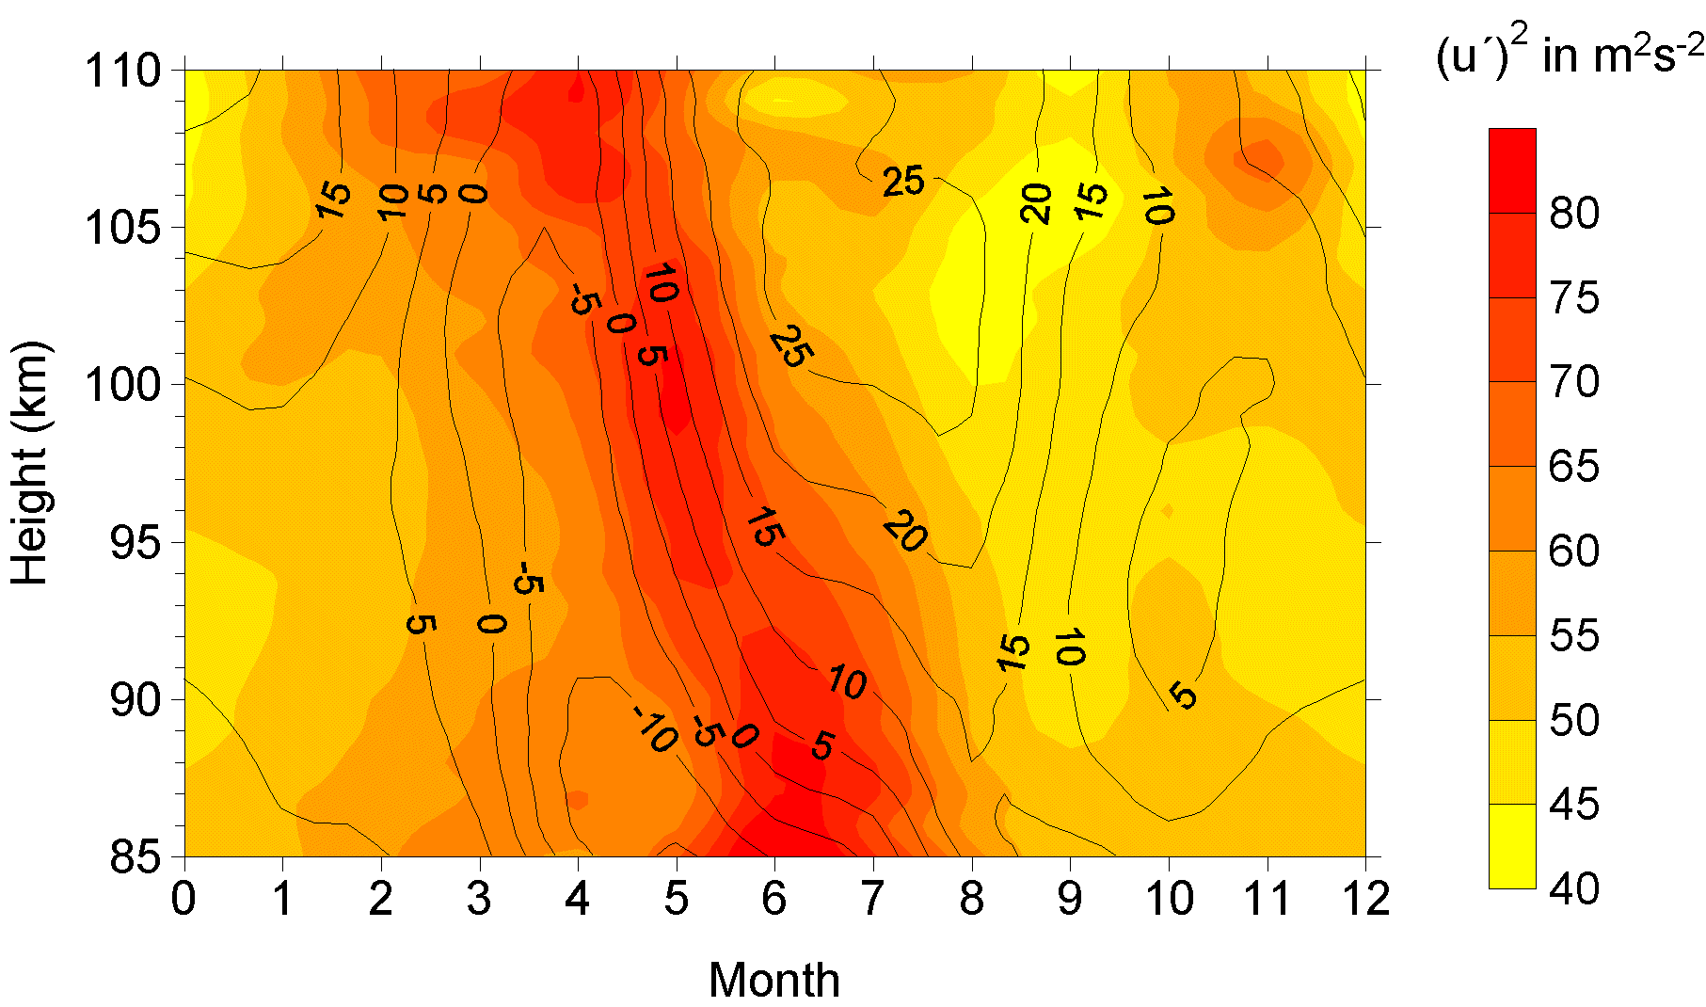

Variety (Complexity)
Relational Data (Tables/Transaction/Legacy Data)
Text Data (Web)
Semi-structured Data (XML)
Graph Data
Social Network, Semantic Web (RDF), …
Streaming Data
You can only scan the data once
A single application can be generating/collecting many types of data
Big Public Data (online, weather, finance, etc)

Slide 17

Velocity (Speed)
Data is begin generated fast and need to be processed fast
Online Data Analytics
Late decisions ➔ missing opportunities
Examples
E-Promotions: Based on your current location, your purchase history, what you like ➔ send promotions right now for store next to you
Healthcare monitoring: sensors monitoring your activities and body ➔ any abnormal measurements require immediate reaction

Slide 18
Challenges of Big Data
Rapid Data Growth: The growth velocity at such a high rate creates a problem to look for insights using it.
Storage: The generation of such a massive amount of data without suitable tools and technologies.
Unreliable Data: Redundant data, contradicting data, or incomplete data.
Data Security: Leads to cybercrimes and risk of data stolen.

Slide 19
Sources of Big Data
Three primary sources of Big Data:-
Social data: comes from the Likes, Tweets & Retweets, Video/Audio Uploads, via the world’s popular social media platforms.
Machine data: created as information which is generated by industrial equipment, sensors like medical devices, smart meters, road cameras, satellites, games etc..
Transactional data: generated from all the daily transactions that take place both online and offline. Invoices, payment orders, storage records, delivery receipts.

Slide 20
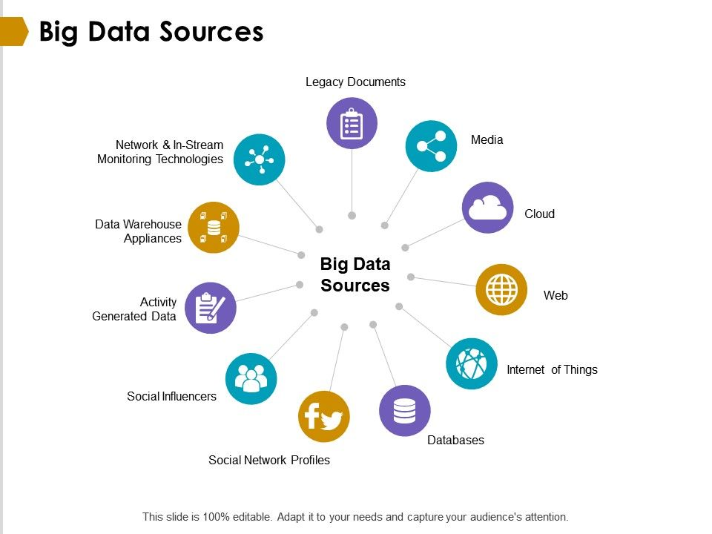

Slide 21
How to deal with Un-structured data ?
Today’s 80% of data in enterprise considered as un-structured data.
There can be following techniques:
Data Mining
Natural Language Processing (NLP)
Text Analysis
Noisy text Analysis

Slide 22
Different Types of Big Data Analytics
There are FOUR type of Big Data Analytics:
Descriptive Analytics:-This summarizes past data into a form that people can easily read. This helps in creating reports, like a company’s revenue, profit, sales, and so on.
Predictive Analytics:- This type of analytics looks into the historical and present data to make predictions of the future.
Prescriptive Analytics:-This type of analytics prescribes the solution to a particular problem. Perspective analytics works with both descriptive and predictive analytics.
Diagnostic Analytics:-This is done to understand what caused a problem in the first place. Techniques like drill-down, data mining, and data recovery are examples of this type.

Slide 23
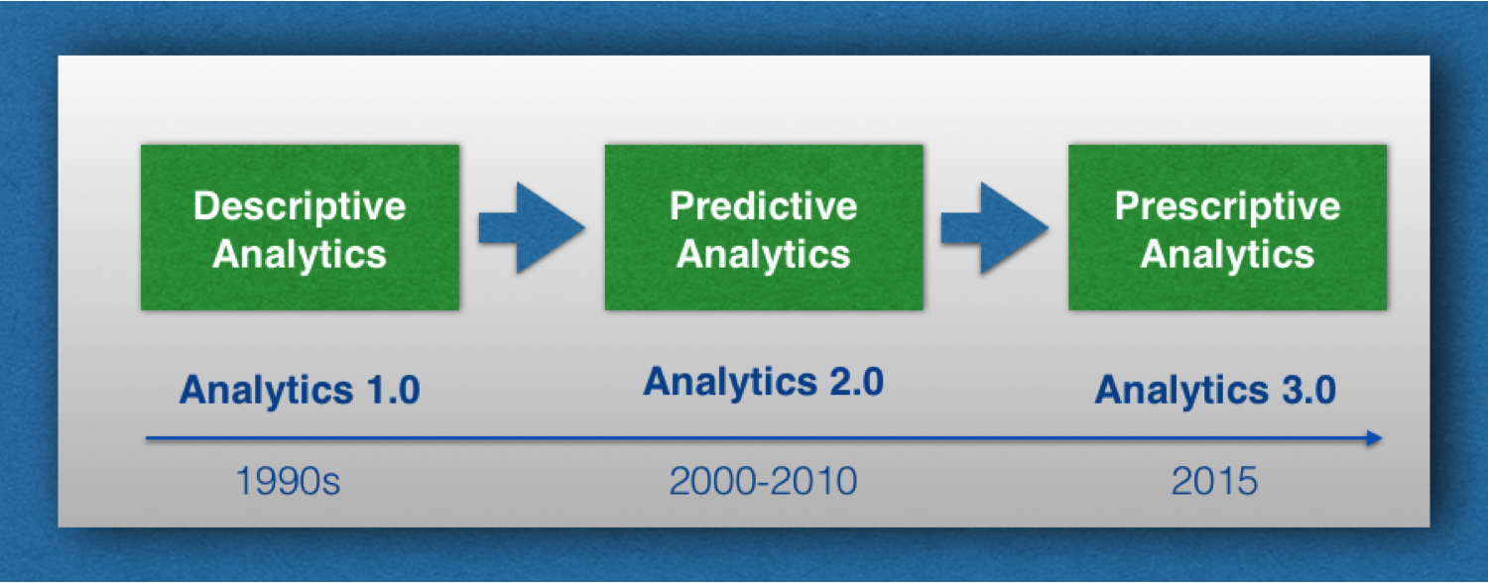

Slide 24
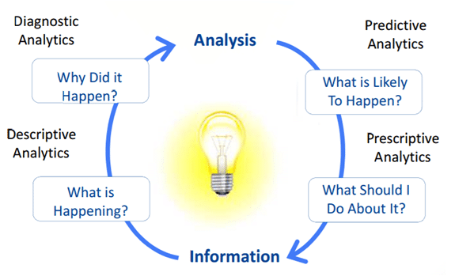
Different Types of Big Data Analytics

Slide 25
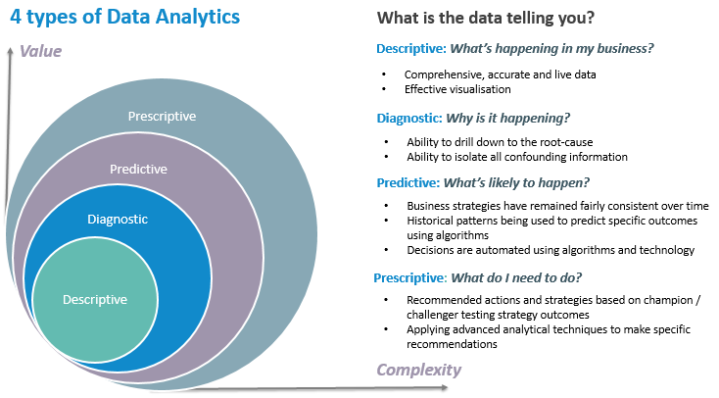

Slide 26
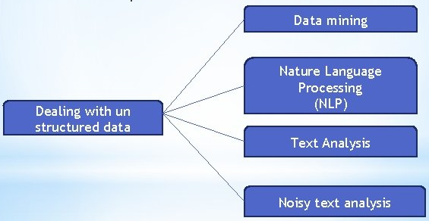
Techniques to deal Unstructured data

Slide 27
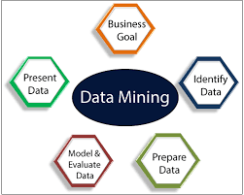
Data Mining
Extracting useful information from large set of data using algorithms & techniques is known as “Data Mining”.
This can be done by finding consistent patterns in large datasets or systematic relationship between used parameters.

Slide 28
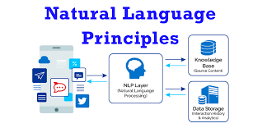
Natural Language Processing (NLP)
It refers to the branch of artificial intelligence with giving computers the ability to understand text and spoken words in much the same way human beings can.

Slide 29
Text Analysis
It aims to extract machine-readable information from unstructured text in order to enable data-driven approaches towards managing content.
Text Analysis is to create structured data out of free or un-structured text content/data.

Slide 30

Text Analysis

Slide 31
Noisy Text Analysis
It is process of extracting structured or semi- structured information from noisy unstructured data like chats, blogs, Wikipedia, emails, short message service (SMS).
The noisy unstructured data usually comprises one or more of following:
Spelling mistakes
Abbreviations like: Dr., Prof. Mr.
Acronyms like UGC, AICTE, GLA
Missing characters in word like “um”, “ur”

Slide 32
Data Warehouse
A data warehouse is a type of data management system that is designed to enable and support business intelligence (BI) activities, especially analytics.
Data warehouses are solely intended to perform queries and analysis and often contain large amounts of historical data.
The data within a data warehouse is usually derived from a wide range of sources such as application log files and transaction applications.

Slide 33
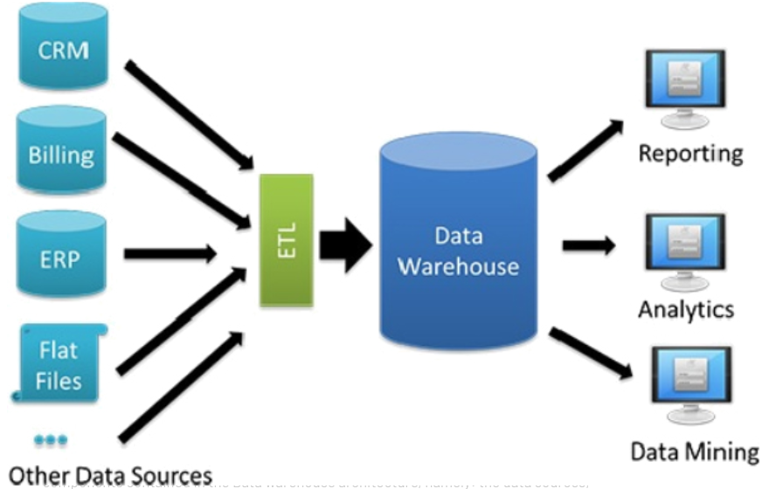

Slide 34
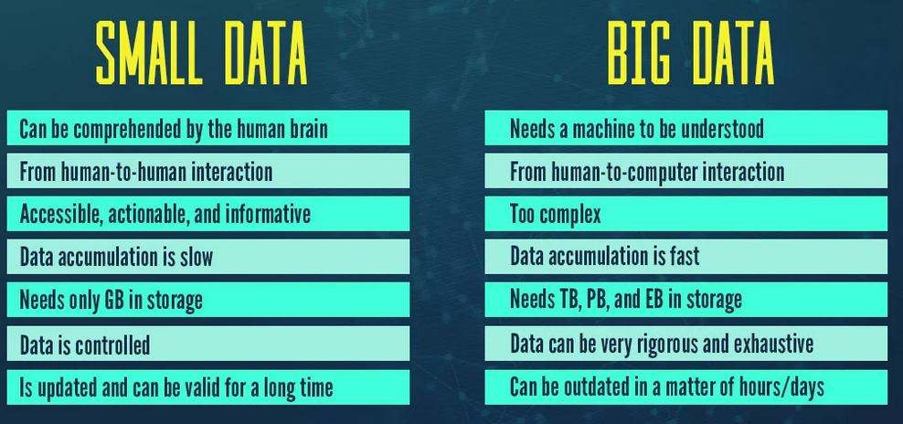
Small Data Vs Big Data

Slide 35
Small Data Vs Big Data
Feature | Small Data | Big Data
Technology | Traditional | Modern
Collection | Generally, it is obtained in an organized manner than is inserted into the database, e.g. table | The Big Data collection is via AWS Kinesis or Google Pub / Sub to balance high-speed data
Volume | Data in the range of tens or hundreds of Gigabytes | Size of Data is more than Terabytes
Analysis Areas | Data marts(Analysts) | Clusters(Data Scientists)
Quality | Contains less noise as data is less collected in a controlled manner | Usually, the quality of data is not guaranteed
Processing | It requires batch-oriented processing pipelines | It has both batch and stream processing pipelines
Database | SQL | NoSQL
Velocity | Constant flow of data, data aggregation is slow | Data arrives at extremely high speeds, large volumes of data aggregation in a short time
Structure | Structured data in tabular with fixed schema(Relational) | Numerous variety of data set including tabular data, text, audio, images, video, logs, JSON etc.(Non Relational)
Scalability | Usually vertically scaled | Usually horizontally scaling architectures

Slide 36
Relational Database (RDBMS)
Schema: A database schema is the skeleton structure that represents the logical view of the entire database.
It defines how the data is organized and how the relations among them are associated.
It can be divided broadly into TWO categories −
Physical Database Schema − This schema pertains to the actual storage of data. For example: files, indices, etc. It defines how the data will be stored in a secondary storage.
Logical Database Schema − This schema defines all the logical constraints that need to be applied on the data stored. It defines tables, views, and integrity constraints.

Slide 37
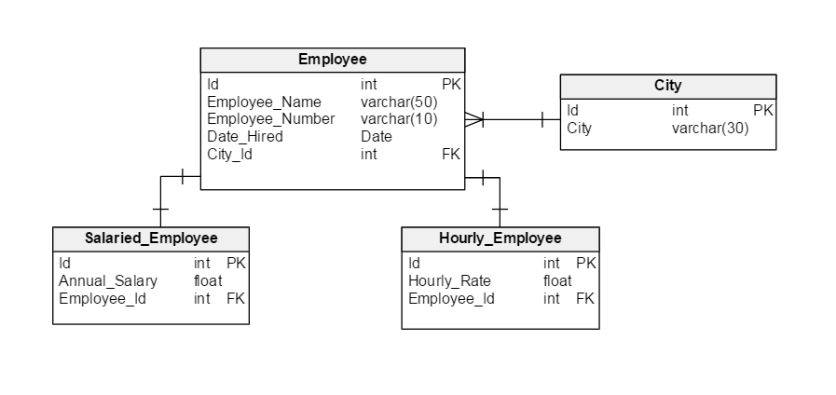
RDBMS Schema

Slide 38
Traditional RDBMS Vs Big Data
S.No | Traditional RDBMS | Big Data
1. | Traditional row-column based databases, basically used for data storage, manipulation and retrieval. | An open-source software used for storing data and running applications or processes concurrently.
2. | structured data is mostly processed. | both structured and unstructured data is processed.
3. | best suited for OLTP environment. | best suited for BIG data.
4. | less scalable than Hadoop. | highly scalable.
5. | Data normalization is required in RDBMS. | Data normalization is not required in Big Data.
6. | Stores transformed and aggregated data. | Stores huge volume of data.
7. | No latency in response. | It has some latency in response.
8. | The data schema of RDBMS is static type. | The data schema is dynamic type.
9. | High data integrity available. | Low data integrity available than RDBMS.
10. | Cost is applicable for licensed software. | Free of cost, as it is an open source software.

Slide 39
Benefits of Big Data Usage
Cost & Management
Economies of scale, “out-sourced” resource management
Reduced Time to deployment
Ease of assembly, works “out of the box”
Scaling
On demand provisioning, co-locate data and compute
Reliability
Massive, redundant, shared resources
Sustainability
Hardware not owned

Slide 40
Terminologies in Big Data Environments
In-Memory Analytics
In-Database Processing
Massively Parallel Processing (MPP)
Symmetric Multiprocessor System (SMP)
Parallel & Distributed System
Shared Nothing Architecture

Slide 41
In-Memory Analytics
Data access from non-volatile storage such as hard disk is a slow process. One way to combat this challenge is to pre-process and store data (cubes, aggregate tables, query sets, etc.) so that the CPU has to fetch a small subset of records. But this requires thinking in advance.
This problem has been addressed using in-memory analytics. Here all the relevant data is stored in RAM.
The advantage is faster access, rapid deployment, better insights, and minimal IT involvement.

Slide 42
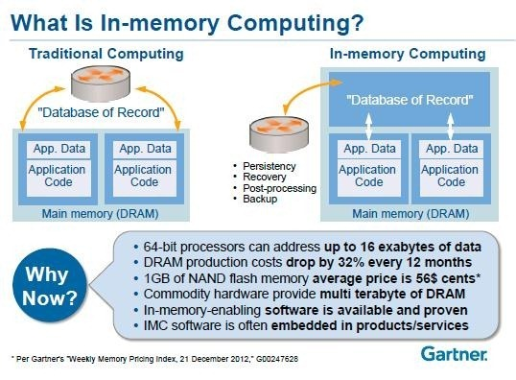

Slide 43
In-Database Processing
In-database processing is also called as in-database analytics. It works by fusing data warehouses with analytical systems.
Typically the data from various enterprise OLTP systems after cleaning up (de-duplication, scrubbing, etc.) through the process of ETL is stored in the Enterprise Data Warehouse (EDW) or data marts.
With in-database processing, the database program itself can run the computations eliminating the need for export and thereby saving on time.

Slide 44
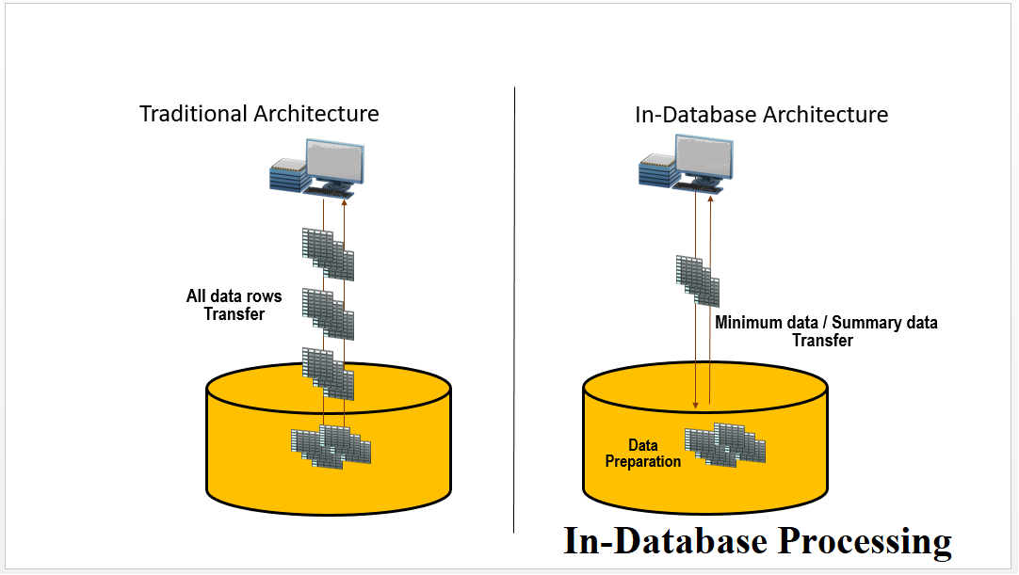

Slide 45
Symmetric Multiprocessor System (SMP)
In SMP, there is a single common main memory that is shared by two or more identical processors.
The processors have full access to all I/O devices and are controlled by a single operating system instance.
SMP are tightly coupled multiprocessor systems.
Each processor has its own high-speed memory, called cache memory and are connected using a system bus.

Slide 46
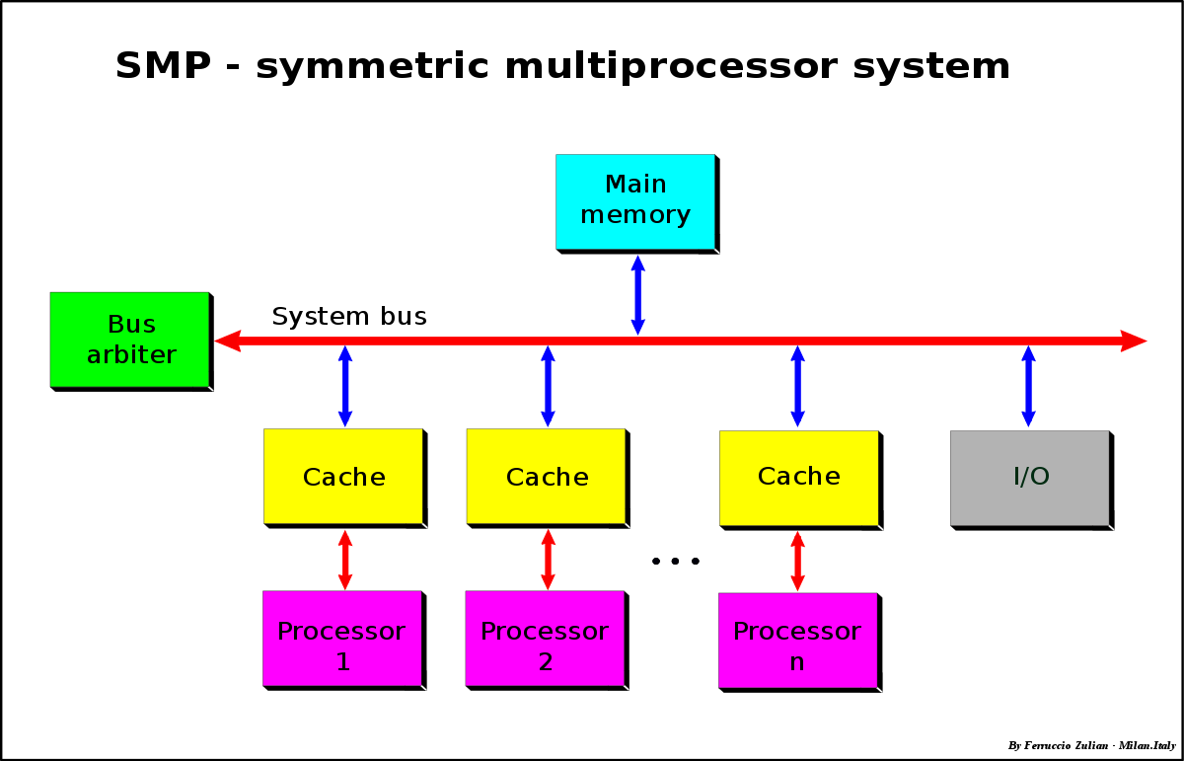

Slide 47
Massively Parallel Processing
MPP refers to the coordinated processing of programs by a number of processors working in parallel fashion.
The processors, each have its own operating systems, dedicated memory & I/O subsytem.
It work on different parts of the same program.
MPP processors communicate using some sort of messaging interface.

Slide 48
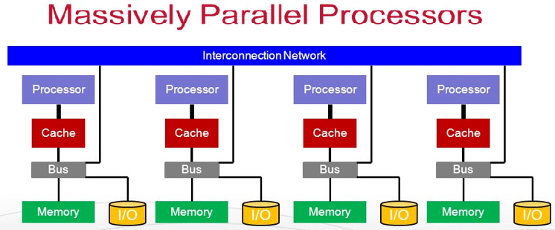

Slide 49
Parallel and Distributed Database System
A parallel database system is a tightly coupled system. The processor co-operate for query processing and user is unaware of such parallelism.
Distributed database systems are known to be loosely coupled and are composed by individual machines. Each of the machines can run their individual application and serve their own respective users. The data is usually distributed across several machines.

Slide 50
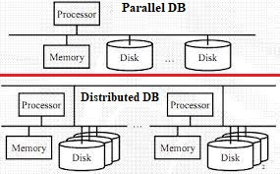
Parallel and Distributed Database (DB) System

Slide 51
Shared Nothing Architecture
In shared nothing architecture, neither memory nor disk have been shared among multiple processors.
Advantages:
Fault Isolation
Scalability

Slide 52
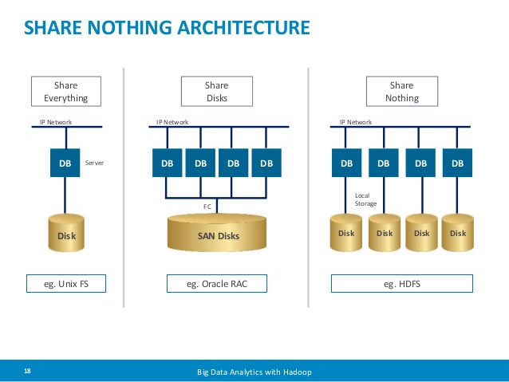

Slide 53
Applications of Big Data
Big Data in the Banking and Securities Industry
Big Data in Communications, Media and Entertainment
Big Data in Healthcare
Big data in Manufacturing
Big data in Retail Trade & E-Commerce Industry

Slide 54
Scalability Concept in Big Data
The scalability can be measured by the number of requests it can effectively support simultaneously.
The limit is reached when a critical hardware resource runs out, requiring different or more machines.
Scaling these resources can include any combination of adjustments to CPU and physical memory, hard disk , and/or the network devices

Slide 55
Type of Scalability
Scaling up: This vertical type of scaling means changing your server with a faster one that has more powerful resources (processors and memory). Also, known as Vertical Scalability.
Scaling out: This horizontal type of scaling means using more servers for parallel computing. Also, known as Horizontal Scalability.

Slide 56
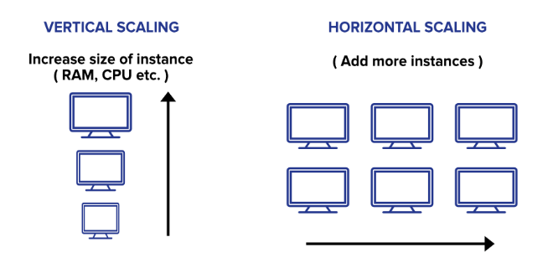

Slide 57
CAP Theorem
In theoretical computer science, the CAP theorem, also named Brewer's theorem after computer scientist Eric Brewer, stated for a distributed data store and stands for:
Consistency: Every read receives the most recent write or an error.
Availability: Every request receives a response, with the guarantee that it contains the most recent write.
Partition Tolerance: The system continues to operate, rather than arbitrary number of messages being dropped (or delayed) by the network between nodes.

Slide 58
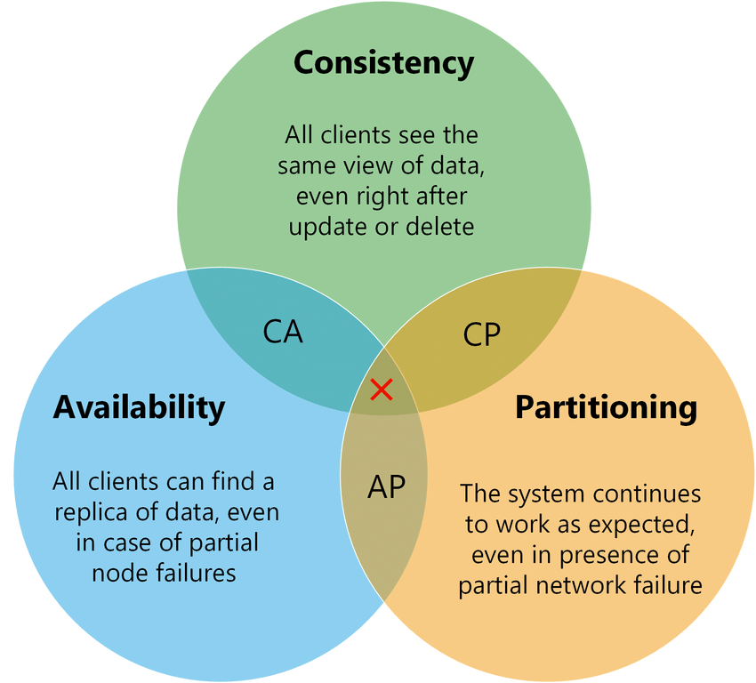

Slide 59
Distributed Computing Environment
In computing, the Distributed Computing Environment (DCE) software system was developed in the early 1990s from the work of the Open Software Foundation (OSF).
Provide Set of tools and services which simply supports the development and operation of distributed applications.
Example: “Middleware” based on client server model.

Slide 60
Distributed Computing Environment
DCE is based on three distributed computing models:
Client/server: A way of organizing a distributed application
Remote procedure call: A way of communicating between parts of a distributed application
Shared files: A way of handling data in a distributed system, based on a personal computer file access model.

Slide 61
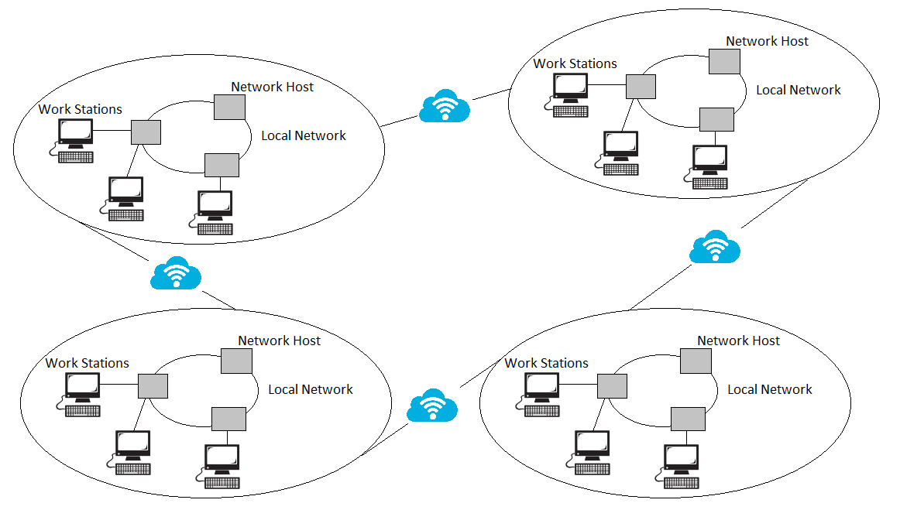
Distributed Computing Environment

Slide 62
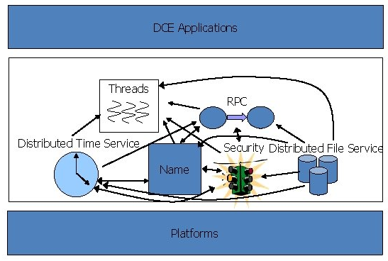

Slide 63
Advantages of Distributed Computing
Reliability, high fault tolerance: A system crash on one server does not affect other servers.
Scalability: In distributed computing systems you can add more machines as needed.
Flexibility: It makes it easy to install, implement and debug new services.
Fast calculation speed: A distributed computer system can have the computing power of multiple computers, making it faster than other systems.
Openness: Since it is an open system, it can be accessed both locally and remotely.
High performance: Compared to centralized computer network clusters, it can provide higher performance and better cost performance.

Slide 64
Disadvantages of Distributed Computing
Difficult troubleshooting: Troubleshooting and diagnostics are more difficult due to distribution across multiple servers.
Less software support: Less software support is a major drawback of distributed computer systems.
High network infrastructure costs: Network basic setup issues, including transmission, high load, and loss of information.
Security issues: The characteristics of open systems make data security and sharing risks in distributed computer systems.

Slide 65
Example of Distributed Computing
Telecommunication Networks like cellular networks & wireless sensor networks
World Wide Web & peer-to-peer networks
Real-Time Process Control: industrial control systems
Parallel Computation like cluster computing, & cloud computing

Slide 66
Jaccard Similarity
The Jaccard index, also known as the Jaccard similarity coefficient, is a statistic used for gauging the similarity and diversity of sample sets. It was developed by Paul Jaccard, originally giving from the French name.

Slide 67
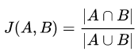
How to Calculate the Jaccard Index
The formula to find the Index is:
Jaccard Index = (the number in both sets) / (the number in either set) * 100
The same formula in notation is:

Slide 68
The Jaccard Distance
The Jaccard distance measures the dissimilarity between two datasets and is calculated as:
Jaccard distance = 1 – Jaccard Similarity

Slide 69
Example
A simple example using set notation: How similar are these two sets?
A = {0,1,2,5,6}
B = {0,2,3,4,5,7,9}
Solution: J(A,B) = |A∩B| / |A∪B| =
=|{0,2,5}| / |{0,1,2,3,4,5,6,7,9}|
= 3/9 = 0.33.
Jaccard Index= 0.33 * 100 = 33

Slide 70
Another Example
E = ['cat', 'dog', 'hippo', 'monkey']
F = ['monkey', 'rhino', 'ostrich', 'salmon']
Number of observations in both, i.e. |E ∩ F|:
= {‘monkey’} = 1
Number of observations in either, i.e. |E ∪ F| : ={‘cat’, ‘dog’, hippo’, ‘monkey’, ‘rhino’, ‘ostrich’, ‘salmon’} = 7
Jaccard Similarity: 1 / 7= 0.142857

Slide 71

What is Hadoop?
Apache top level project, open-source implementation of frameworks for reliable, scalable, distributed computing and data storage.
It is a flexible and highly-available architecture for large scale computation and data processing on a network of commodity hardware.

Slide 72
Framework Vs Library
Library : It performs a set of specific and well-defined operations. Examples : Network protocols, compression, image manipulation, string utilities, regular expression evaluation, math etc
Framework: It is known to be a skeleton where the application defines the content of the operation by filling out the skeleton. Examples of frameworks: Web application system, Plug-in manager, GUI system. The framework only defines the concept but an application further defines the functionality that is useful for end-users.

Slide 73
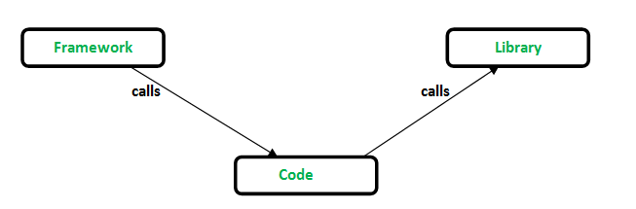
Inversion of control: When we call a method from a library, we are in control. But in framework, the control is inverted i.e. the framework calls us.

Slide 74

Apache Hadoop
Apache Hadoop is a framework that allows for the distributed processing of large data sets across clusters of computers using simple programming models.
It is designed to scale up from single servers to thousands of machines, each offering local computation and storage.
Rather than rely on hardware to deliver high-availability, the library itself is designed to detect and handle failures at the application layer, so delivering a highly-available service on top of a cluster of computers, each of which may be prone to failures.

Slide 75
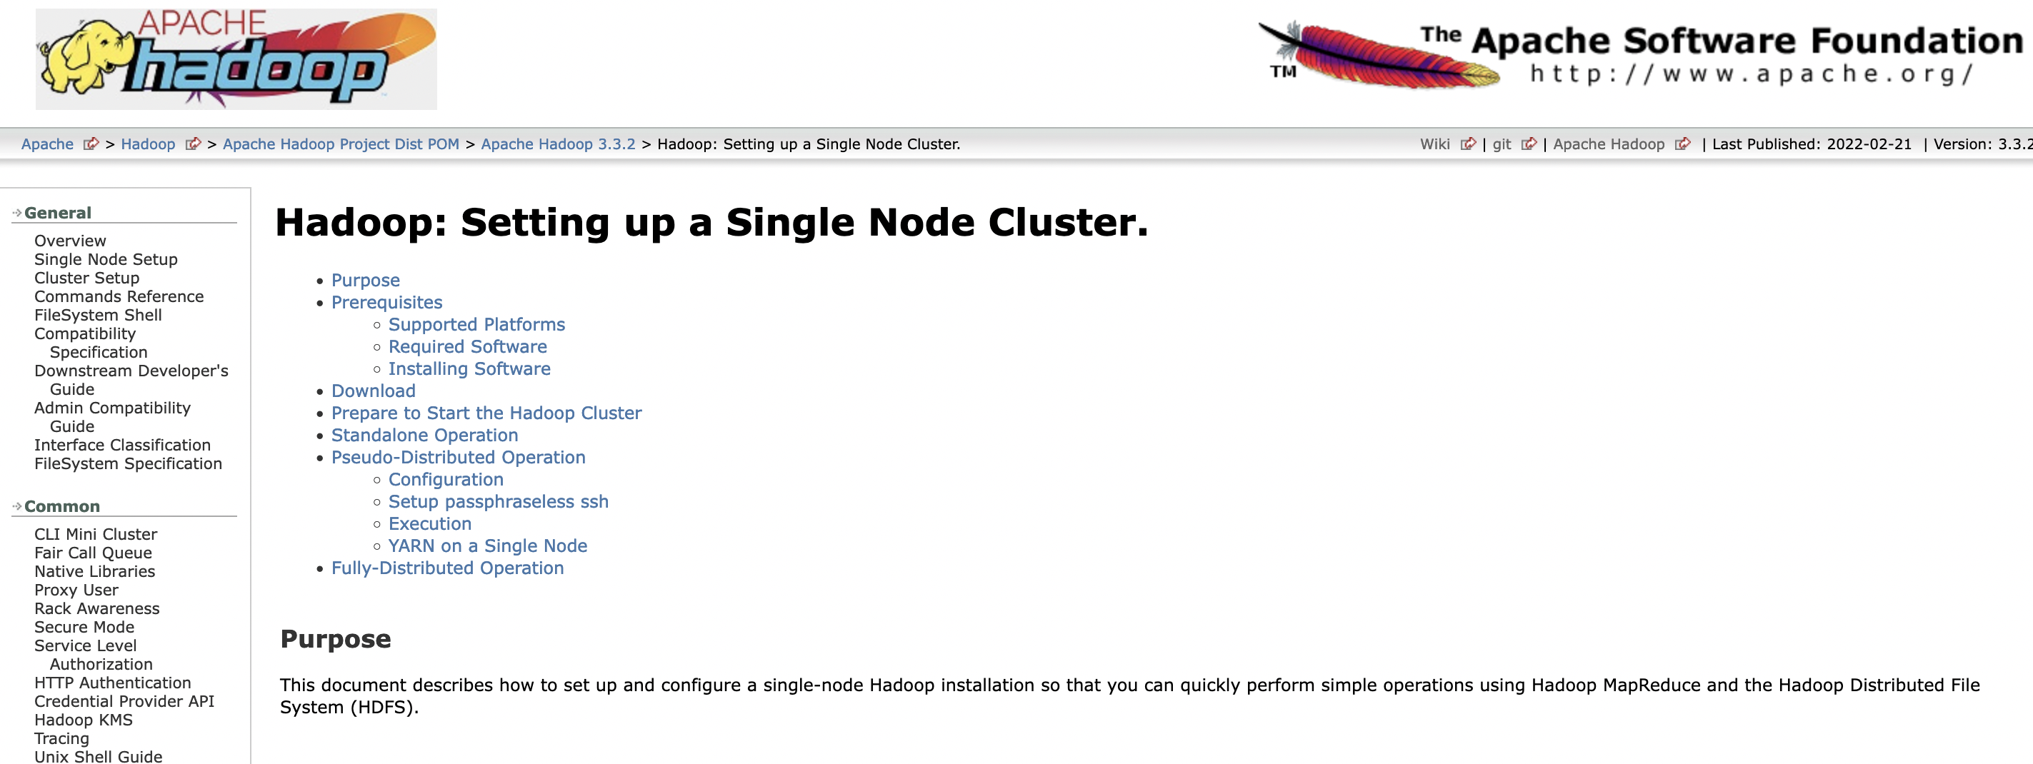

Slide 76
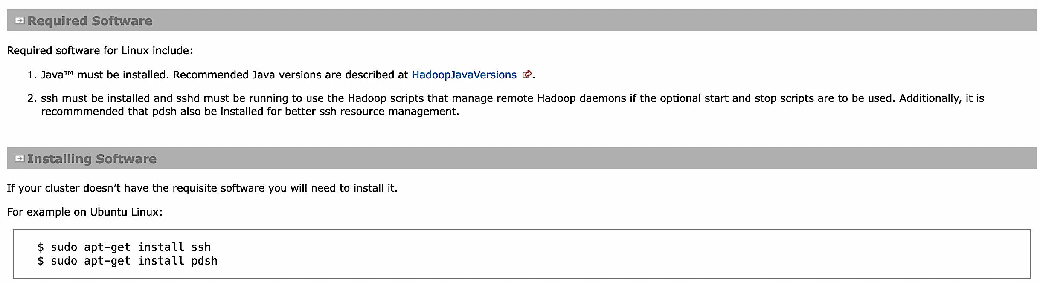

Slide 77
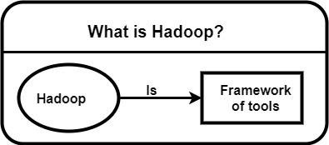
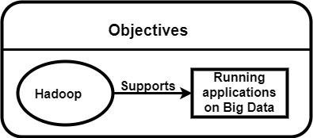
Hadoop Can do:-
Process large & complex datasets effectively.
Work with structure & un-structure data.
Max/Min Size is 128MB data in each cluster of Node.

Slide 78
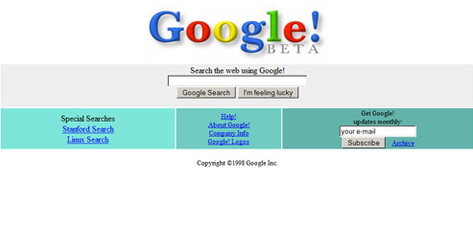
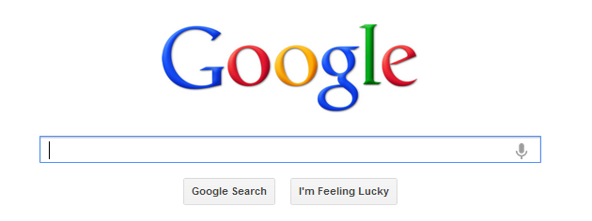
Google Search Engines
1998
2022

Slide 79





Hadoop’s Developers
2005: Doug Cutting & Michael J. Cafarella developed Hadoop to support distribution for the Nutch search engine project.
The project was funded by Yahoo.
2006: Yahoo gave the project to Apache
Software Foundation.
Doug Cutting
Michael J. Cafarella

Slide 80
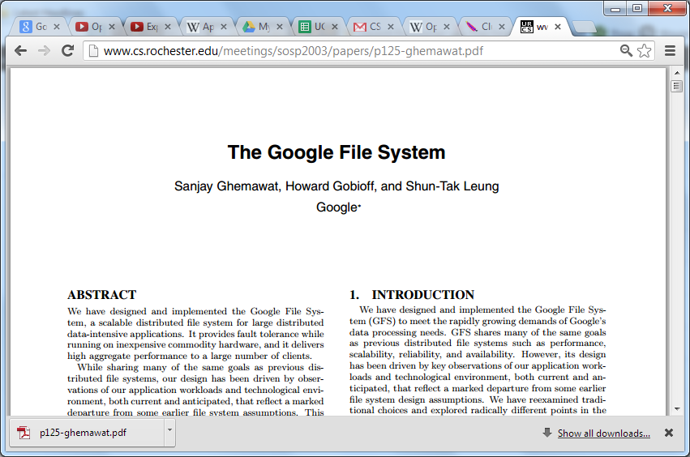

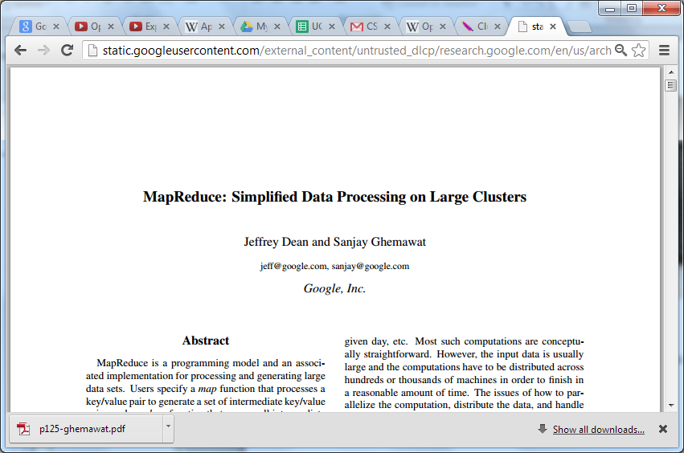


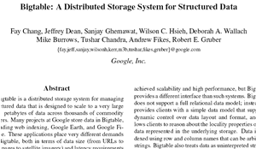
Hadoop Origins
2003
2004
2006

Slide 81

Some Hadoop Milestones
2008 - Hadoop Wins Terabyte Sort Benchmark (sorted 1 terabyte of data in 209 seconds, compared to previous record of 297 seconds)
2009 - Avro and Chukwa became new members of Hadoop Framework family
2010 - Hadoop's Hbase, Hive and Pig subprojects completed, adding more computational power to Hadoop framework
2011 - ZooKeeper Completed
2013 - Hadoop 1.1.2 and Hadoop 2.0.3 alpha.
- Ambari, Cassandra, Mahout have been added

Slide 82
HDFS Facts
In 2010, Facebook claimed to have one of the largest HDFS cluster storing 21 Petabytes of data.
In 2012, Facebook declared that they have the largest single HDFS cluster with more than 100 PB of data.
And Yahoo! has more than 100,000 CPU in over 40,000 servers running Hadoop, with its biggest Hadoop cluster running 4,500 nodes. All told, Yahoo! stores 455 petabytes of data in HDFS.
In fact, by 2013, most of the big names in the Fortune 50 started using Hadoop.

Slide 83
Distributed File System
Distributed File System talks about managing data, i.e. files or folders across multiple computers or servers.
DFS is a file system that allows us to store data over multiple nodes or machines in a cluster and allows multiple users to access data.
Even though the files are stored across the network,
DFS organizes, and displays data in such a manner that a user sitting on a machine will feel like all the data is stored in that very machine.

Slide 84
HDFS (HADOOP DISTRIBUTED FILE SYSTEM)
1. Storage component of Hadoop.
2. Distributed File System.
3. Modeled after Google File System.
4. Optimized for high throughput (HDFS leverages large block size and moves computation where data is stored).
5. You can replicate a file for a configured number of times, which is tolerant in terms of both software and hardware.
6. Re-replicates data blocks automatically on nodes that have failed.
7. You can realize the power of HDFS when you perform read or write on large files (gigabytes and larger).
8. Sits on top of native file system such as ext3 and ext4, which is described

Slide 85
Why Hadoop
Its capability to handle massive amount of data, different categories of data – fairly & quickly.
Low Cost
Computing Power
Scalability
Storage Flexibility
Inheritance Data Protection.

Slide 86
Hadoop Framework
IBM Definition
Apache Hadoop is an open source software framework that provides highly reliable distributed processing of large data sets using simple programming models.
Hadoop, known for its scalability, is built on clusters of commodity computers, providing a cost-effective solution for storing and processing massive amounts of structured, semi-structured and unstructured data with no format requirements.
It provides a software framework for distributed storage and processing of big data using the MapReduce programming model.

Slide 87
Hadoop Core Concept
The base Apache Hadoop framework is composed of the following modules:
Hadoop Distributed File System (HDFS) – a distributed file-system that stores data on commodity machines, providing very high aggregate bandwidth across the cluster.
Hadoop YARN – (introduced in 2012) a platform responsible for managing computing resources in clusters and using them for scheduling users' applications.
Hadoop MapReduce – an implementation of the MapReduce programming model for large-scale data processing.
Hadoop Common (others) – contains libraries and utilities needed by other Hadoop modules.

Slide 88
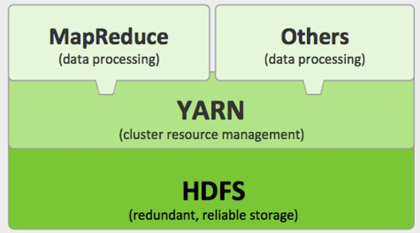
Hadoop Core Components

Slide 89
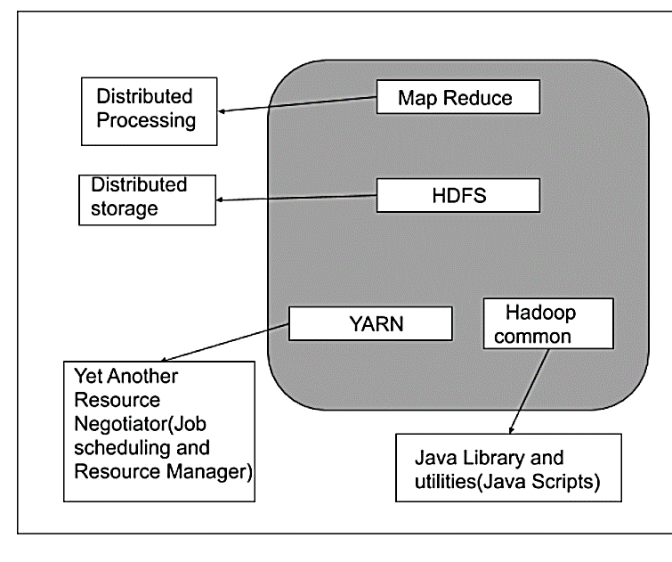
Hadoop Core Components

Slide 90
Hadoop Architecture
The Hadoop architecture is a package of the file system, MapReduce engine and the HDFS (Hadoop Distributed File System). The MapReduce engine can be MapReduce/MR1 or YARN/MR2.
A Hadoop cluster consists of a single master and multiple slave nodes. The master node includes Job Tracker, Task Tracker, NameNode, and DataNode whereas the slave node includes DataNode and TaskTracker.

Slide 91
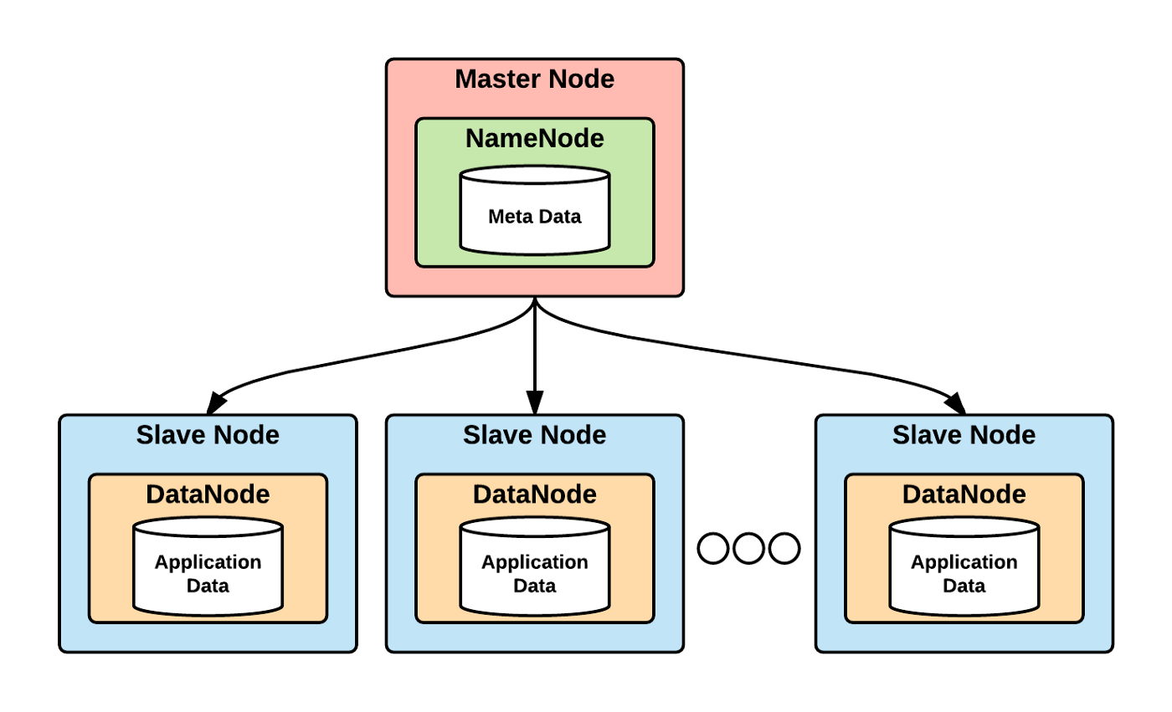

Slide 92
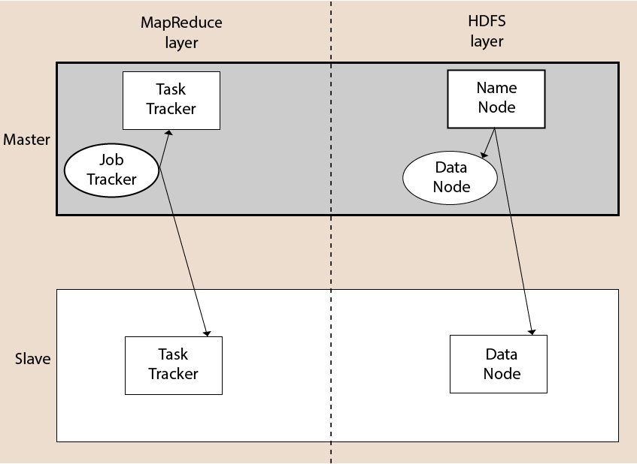
Hadoop Conceptual Layer
Hadoop High Level Architecture

Slide 93
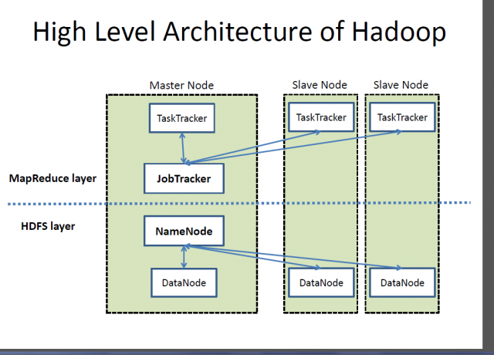

Slide 94
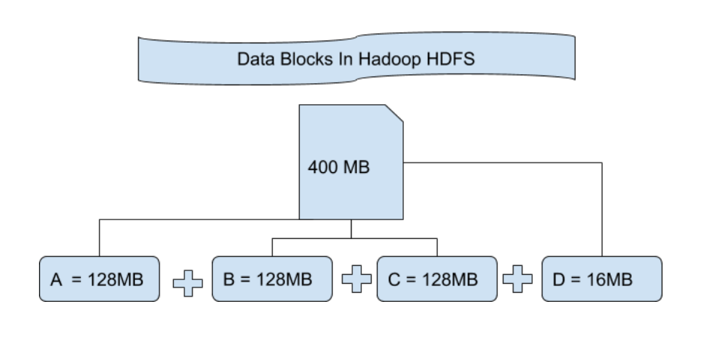
HDFS
It is Hadoop Distributed File System which is utilized for storage permission is a Hadoop cluster.
HDFS provides Fault-tolerance and High availability to the storage layer.

Slide 95
Hadoop Cluster
Hadoop cluster is also a collection of various commodity hardware(devices that are inexpensive and amply available). This Hardware components work together as a single unit.
We design Hadoop clusters for storing, analyzing, understanding, and for finding the facts that are hidden behind the data or datasets which contain some crucial information.

Slide 96


Slide 97


Slide 98


Slide 99
Nodes in HDFS
There are two types of nodes in hadoop:- Name Node and Data Node. It is called as a “node“ as all these computers are interconnected. NameNode is also known as the Master node.
A node in hadoop simply means a computer that can be used for processing and storing.
Master node in hadoop, is responsible for storing data in HDFS and executing parallel computation of stored data using MapReduce.
Master Node has 3 nodes – NameNode, Secondary NameNode and JobTracker.
Slave nodes in Hadoop, is stored and where data processing takes place.

Slide 100
JobTracker
It process runs on a separate node and not usually on a DataNode.
It is an essential Program/Daemon for MapReduce.
It receives the requests for MapReduce execution from the client.
It talks to the NameNode to determine the location of the data.
When the JobTracker is down, HDFS will still be functional but the MapReduce execution can not be started and the existing MapReduce jobs will be halted.

Slide 101
TaskTracker
It runs on DataNode. Mostly on all DataNodes. It is replaced by “NodeManager” in Mapreduce Version 2 (MRv2).
Mapper and Reducer tasks are executed on DataNodes administered by TaskTrackers.
TaskTrackers will be assigned Mapper and Reducer tasks to execute by JobTracker.
TaskTracker will be in constant communication with the JobTracker signalling the progress of the task in execution.
TaskTracker failure is not considered fatal. When a TaskTracker becomes unresponsive, JobTracker will assign the task executed by the TaskTracker to another node.

Slide 102
Master Node
NameNode: It is the master Daemon in Hadoop HDFS. It maintains the filesystem namespace. It stores metadata about each block of the files.
ResourceManager: It is the master daemon of YARN. It arbitrates resources amongst all the applications running in the cluster.

Slide 103
Slave Node
DataNode: DataNode is the slave node/daemon of Hadoop HDFS. It runs on slave machines. It stores actual data or blocks.
NodeManager: It is the slave node/daemon of YARN. It takes care of all the individual computing nodes in the cluster.
NodeManager: Coordinates the resources for an individual slave node and reports back to the Resource Manager.

Slide 104
MapReduce
MapReduce nothing but just like an Algorithm or a data structure that is based on the YARN framework.
The major feature of MapReduce is to perform the distributed processing in parallel in a Hadoop cluster.
In first phase, Map is utilized and in next phase Reduce is utilized.

Slide 105

MapReduce
The Map() function here breaks this DataBlocks into Tuples which is a “key-value pair”.
The Reduce() function then combines this broken Tuples or key-value pair to desired OUTPUT.

Slide 106

What is MapReduce Programming?
MapReduce Programming is a software framework. MapReduce Programming helps you to process massive amounts of data in parallel.

Slide 107
How MapReduce Works
MapReduce are two functions:
Map and Reduce.
It has sequenced one after the other.
The Map function takes input from the disk as <key,value> pairs, processes them, and produces another set of intermediate <key,value> pairs as output.
The Reduce function also takes inputs as <key,value> pairs, and produces <key,value> pairs as output.

Slide 108


Slide 109

How MapReduce Works

Slide 110

MapReduce Daemons
Job Tracker Task Tracker

Slide 111
JobTracker
It process runs on a separate node and not usually on a DataNode.
It is an essential Program/Daemon for MapReduce.
It receives the requests for MapReduce execution from the client.
It talks to the NameNode to determine the location of the data.
When the JobTracker is down, HDFS will still be functional but the MapReduce execution can not be started and the existing MapReduce jobs will be halted.

Slide 112
TaskTracker
It runs on DataNode. Mostly on all DataNodes. It is replaced by “NodeManager” in Mapreduce Version 2 (MRv2) – Hadoop 2.0.
Mapper and Reducer tasks are executed on DataNodes administered by TaskTrackers.
TaskTrackers will be assigned Mapper and Reducer tasks to execute by JobTracker.
TaskTracker will be in constant communication with the JobTracker signalling the progress of the task in execution.
TaskTracker failure is not considered fatal. When a TaskTracker becomes unresponsive, JobTracker will assign the task executed by the TaskTracker to another node.

Slide 113
Yet Another Resource Negotiator (YARN)
YARN performs 2 operations:- Job scheduling and Resource Management.
Purpose of Job schedular is to divide a big task into small jobs so that each job can be assigned to various slaves in a Hadoop cluster and Processing can be Maximized.
Job Scheduler also keeps track of which job is important, which job has more priority, dependencies between the jobs and all the other information like job timing, etc.
Resource Manager is to manage all the resources that are made available for running a Hadoop cluster.

Slide 114

Yet Another Resource Negotiator (YARN)

Slide 115

YARN Daemons
Resource Manager Node Manager

Slide 116
Features of YARN
Multi-Tenancy
Scalability
Cluster-Utilization
Compatibility

Slide 117
Advantages of Hadoop
Fast: In HDFS, the data distributed over the cluster and are mapped which helps in faster retrieval.
Scalable: Hadoop cluster can be extended by just adding nodes in the cluster.
Cost Effective: Hadoop is open source and uses commodity hardware to store data.
Resilient to failure: HDFS has the property with which it can replicate data over the network.

Slide 118
How Hadoop Works ?
Hadoop stores and processes the data in a distributed manner across the cluster of commodity hardware.
To store and process any data, the client submits the data and program to the Hadoop cluster.
Hadoop HDFS stores the data, MapReduce processes the data stored in HDFS, and YARN divides the tasks and assigns resources.

Slide 119

How Hadoop Works ?

Slide 120

Step- wise Internal Working
of Hadoop & YARN

Slide 121
Read & Write Operations in HDFS

Slide 122

Anatomy of File Read
Notes:
When a user wants to read a file, the client will talk to namenode and namenode will return the metadata of the file. The metadata has information about the blocks and their locations.
When the client receives metadata of the file, it communicates with the datanodes and accesses the data sequentially or parallelly. This way there is no bottleneck in namenode as client talks to namenode only once to get the metadata of the files.
HDFS by design makes sure that no two writers write the same file at the same time by having singular namenode.
If there are multiple namenodes, and clients make requests to these different namenodes, the entire filesystem can get corrupted. This is because these multiple requests can write to a file at the same time.
Let’s understand how files are written to HDFS. When a user uploads a file to HDFS, the client on behalf of the user tells the namenode that it wants to create the file. The namenode replies back with the locations of datanodes where the file can be written. Also, namenode creates a temporary entry in the metadata.
The client then opens the output stream and writes the file to the first datanode. The first datanode is the one which is closest to the client machine. If the client is on a machine which is also a datanode, the first copy will be written on this machine.
Once the file is stored on one datanode, the data gets copied to the other datanodes simultaneously. Also, once the first copy is completely written, the datanode informs the client that the file is created.
The client then confirms to the namenode that the file has been created. The namenode crosschecks this with the datanodes and updates the entry in the metadata successfully.
Now, lets try to understand what happens while reading a file from HDFS.
When a user wants to read a file, the HDFS client, on behalf of the user, talk to the namenode.
The Namenode provides the locations of various blocks of this file and their replicas instead of giving back the actual data.
Out of these locations, the client chooses the datanodes closer to it. The client talks to these datanodes directly and reads the data from these blocks.
The client can read blocks of the file either sequentially or simultaneously.

Slide 123

Anatomy of File Write

Slide 124
HDFS Daemons
NameNode:
Single NameNode per cluster.
DataNode:
Multiple DataNode per cluster
Read/Write operations
SecondaryNameNode:
Housekeeping Daemon

Slide 125
NameNode (Master Node)
NameNode is the master node
It maintains and manages the blocks present on the DataNodes (slave nodes).
NameNode is a very highly available server that manages the File System Namespace and controls access to files by clients.

Slide 127
Functions of NameNode
It is the master daemon that maintains and manages the DataNodes (slave nodes)
It records the metadata of all the files stored in the cluster, e.g. The location of blocks stored, the size of the files, permissions, hierarchy, etc.
There are two files associated with the metadata:
FsImage: It contains the complete state of the file system namespace since the start of the NameNode. It is having the snapshot of the file system with which Namenode will start for very first time.
EditLogs: Whatever operations i.e write, delete, update, etc with respect to the most recent FsImage, it stores and keeps all on growing during the life of cluster.

Slide 128
Functions of NameNode ……….Continue..
It records each change that takes place to the file system metadata.
For example, if a file is deleted in HDFS, the NameNode will immediately record this in the EditLog.
It regularly receives a Heartbeat and a block report from all the DataNodes in the cluster to ensure that the DataNodes are live.
It keeps a record of all the blocks in HDFS and in which nodes these blocks are located.
The NameNode is also responsible to take care of the replication factor of all the blocks.
In case of the DataNode failure, the NameNode chooses new DataNodes for new replicas,
balance disk usage and
manages the communication traffic to the DataNodes.

Slide 129
Blocks Size
Blocks are the nothing but the smallest continuous location on your hard drive where data is stored.
In general, in any of the File System, you store the data as a collection of blocks.
Similarly, HDFS stores each file as blocks which are scattered throughout the Apache Hadoop cluster.
The default size of each block is 128 MB in Apache Hadoop 2.x (64 MB in Apache Hadoop 1.x) which you can configure as per your requirement.

Slide 130

Blocks Size
It is not necessary that in HDFS, each file is stored in exact multiple of the configured block size (128 MB, 256 MB etc.).
Let’s take an example where I have a file “example.txt” of size 514 MB as shown in figure.
Suppose that we are using the default configuration of block size, which is 128 MB.
Then, how many blocks will be created?
5
The first four blocks will be of 128 MB.
But, the last block will be of 2 MB size only.
Blocks are the nothing but the smallest continuous location on your hard drive where data is stored.

Slide 131
Heartbeat Message

Slide 132

Heartbeat
Name node and Data node communicate each other using Heartbeat.
Basically using this heartbeat Name node checks on Data node whether it is alive(functioning) or not.
NameNode should know any DataNode is dead.

Slide 133

Heartbeat

Slide 134


Slide 135
Heartbeat
If the DataNode is dead
If Data node fails to send heartbeat during its time interval than
that Data node is considered as dead and the task of that Data node is reassigned to new Data node.
the NameNode issues commands to other DataNodes to replicate the data stored on the dead DataNode,
to bring the replication factor of the blocks to the configured number of replicas.

Slide 136
Block Report

Slide 137
Block Report
NameNode gets information about what data which is stored on a specific DataNode.
A block report contains the block ID, the generation timestamp and the length for each block replica the server hosts.
Interval of block reports is determined by configuration dfs.blockreport.intervalMsec (in hdfs-site.xml).
By default this is set to 21600000 milliseconds.

Slide 138
Block Report
Some of the information contained in the block report is:
Registration: Data node registration information
blocks: Information about the blocks, which contains:
block ID,
block length,
block generation timestamp,
state of the block replica (For e.g. replica is finalized or waiting to be recovered etc.)

Slide 139
Block Report
This information is used by the Name Node for:
Process first block report:
If it is a first time report for the newly registered Data Node,
it just adds all the valid replicas.
It ignores all the invalid blocks, till the next block report.
For updating the information about blocks:
The (Data Node -> Blocks) map is updated in the Name Node.
The new block report is compared with the old report and information about
successful blocks,
corrupted blocks,
invalidated blocks etc. is updated

Slide 140


Slide 141
If Heartbeat not received??
To make NameNode aware of the status,
each DataNode does the following,
DataNodes send a heartbeat to the NameNode every three seconds by default.
You can set the heartbeat interval in the hdfs-site.xml file by configuring the parameter dfs.heartbeat.interval.
If the NameNode doesn’t receive any heartbeats for a specified time, which is ten minutes by default, it assumes the DataNode is lost and that the block replicas hosted by that DataNode are unavailable.

Slide 142

Heartbeat

Slide 143
What Heartbeat Message contains ?
Registration: Data node registration information
Capacity: Total storage capacity available at Data Node
dfsUsed: Storage used by HDFS
remaining: Remaining storage available for HDFS
blockPoolUsed: Storage used by the block pool
xmitsInProgress: Number of transfers from this Data Node to others
xceiverCount: Number of active transceiver threads
cacheCapacity: Total cache capacity available at Data Node
cacheUsed: Amount of cache used

Slide 144
What namenode do with heartbeat??
This information is used by the Name Node in the following ways:
Health of the Data Node: Should this data node be marked as dead or alive?
Registration of new Data Node: If this is a newly added Data Node, its information is registered
Update the metrics of the Data Node: The information sent in the heart beat is used for updating the metrics of the node
Issue commands to the Data Node: The Name Node can issue following commands to the Data Node, based on the information received in the heart beat:
BlockRecoveryCommand (to recover specified blocks),
BlockCommand (for transferring blocks to another Data Node, for invalidating certain blocks),
Cache/Uncache (commands for caching / uncaching the blocks)

Slide 145
Problems of HDFS
Till now, we have realized that the NameNode is pretty much important to us.
If it fails, we are helpless and system may get failure.
But now we see how Hadoop solved this single point of failure problem.

Slide 146

Secondary NameNode
The Secondary NameNode works concurrently with the primary NameNode as a helper daemon.
And don’t be confused about the Secondary NameNode being a backup NameNode because it is not.

Slide 147
Why Secondary namenode
When the NameNode starts,
the NameNode merges the Fsimage and edit logs file to restore the current file system namespace.
Since the NameNode runs continuously for a long time without any restart, the size of edit logs becomes too large.
This will result in a long restart time for NameNode.
Secondary NameNode solves this issue.

Slide 148


Slide 149
Functions of Secondary NameNode
The Secondary NameNode is one which constantly reads all the file systems and metadata from the RAM of the NameNode and writes it into the hard disk or the file system.
It is responsible for combining the EditLogs with FsImage from the NameNode.
It downloads the EditLogs from the NameNode at regular intervals and applies to FsImage. The new FsImage is copied back to the NameNode, which is used whenever the NameNode is started the next time.

Slide 150
Special Features of HDFS
Data Replication: There is absolutely no need for a client application to track all blocks. It directs the client to the nearest replica to ensure high performance.
Data Pipeline: A client application writes a block to the first DataNode in the pipeline. Then, this DataNode takes over and forwards the data to the next node in the pipeline. This process continues for all the data blocks, and subsequently all the replicas are written to the disk.

Slide 151


Slide 152


Replication Management

Slide 153

Data Pipeline

Slide 154
HDFS Federation

Slide 155

Overview of Current HDFS
HDFS has two main layers:
Namespace manages directories, files and blocks.
It supports file system operations such as creation, modification, deletion and listing of files and directories.
Block Storage has two parts:
Block Management maintains the membership of datanodes in the cluster. It supports block-related operations such as creation, deletion, modification and getting location of the blocks. It also takes care of replica placement and replication.
Physical Storage stores the blocks and provides read/write access to it.

Slide 156
Limitations of Current HDFS Architecture
Due to the tight coupling of namespace and the storage layer, an alternate implementation of NameNode is difficult. This limits the usage of block storage directly by the other services.
Due to single NameNode, we can have only a limited number of DataNodes that a single NameNode can handle.
The operations of the filesystem are also limited to the number of tasks that NameNode handles at a time. Thus, the performance of the cluster depends on the NameNode throughput.
Also, because of a single namespace, there is no isolation among the occupant organizations which are using the cluster.

Slide 157
HDFS Federation
HDFS Federation improves the existing HDFS architecture through a clear separation of namespace and storage, enabling generic block storage layer.
It enables support for multiple namespaces in the cluster to improve scalability and isolation.
Federation also opens up the architecture, expanding the applicability of HDFS cluster to new implementations and use cases.

Slide 158
HDFS Federation
Basically what we are doing is trying to have
multiple data nodes, and multiple name nodes
So that we can increase the name space data
So, if you recall from the first design
you have essentially a single node handling all the namespace responsibilities
And you can imagine as you start having thousands of nodes that they'll not scale, and if you have billions of files,
you will have scalability issues
So to address that, the federation aspect was brought in
That also brings performance improvements

Slide 159


Slide 160
HDFS Federation Architecture
In HDFS Federation architecture, there are multiple NameNodes and DataNodes.
Each NameNode has its own namespace and block pool.
All the NameNodes uses DataNodes as the common storage.
Every NameNode is independent of the other and does not require any coordination amongst themselves.
Each Datanode gets registered to all the NameNodes in the cluster and store blocks for all the block pools in the cluster.
Also, DataNodes periodically send heartbeats and block reports to all the NameNode in the cluster and handles the instructions from the NameNodes.

Slide 161
Benefits for HDFS Federation Architecture
Increase namespace scalability
Performance
Isolation

Slide 162

HDFS Erasure Coding
Replication Factor = 3

Slide 163

HDFS Erasure Coding
Consume only 9 blocks

Slide 164
Erasure Coding (EC)
once the data is split into several blocks in HDFS,
it is passed on to EC as input, which returns a number of parity blocks.
This process is known as encoding and
the (data + parity block/s) is known as an encoding group.
In case of a failure aka erasure, the data can be reconstructed from this encoding group, known as decoding.

Slide 165


Slide 166

Replica Placement Strategy
As per the Hadoop Replica Placement Strategy, first replica is placed on the same node.
Then, it places second replica on a node that is present on different rack.
It places the third replica on the same rack as second, but on a different node in the rack.
Once replica locations have been set, a pipeline is built. This strategy provides good reliability.

Slide 167
Hadoop HDFS Commands
With the help of the HDFS command, we can perform Hadoop HDFS file operations.
changing the file permissions
viewing the file contents
creating files or directories
copying file/directory from the local file system to HDFS or vice-versa

Slide 168


Slide 169
Working with HDFS Commands
Objective: To copy a file from local file system to HDFS.
hadoop fs -put /root/sample/test.txt /sample/test.txt
Objective: To copy a file from HDFS to local file system.
hadoop fs -get /sample/test.txt /root/sample/testsample.txt
For more commands, please visit below link:
https://data-flair.training/blogs/top-hadoop-hdfs-commands-tutorial/

Slide 170


Objective: first you need to start the Hadoop services using the following command:
sbin/start-all.sh
Objective: Hadoop services are up and running use the following command:
jsp
Objective: ls: This command is used to list all the files :
bin/hdfs dfs -ls /

Slide 171


Objective: To create a directory (say, sample) in HDFS.
hadoop fs -mkdir /sample
Objective: copy files/folders from local file system to hdfs store. This is the most important command. Local filesystem means the files present on the OS.
bin/hdfs dfs -copyFromLocal <local file path> <dest(present on hdfs)>

Slide 172

HDFS Command

Slide 173

HDFS Command

Slide 174

HDFS Command

Slide 175

HDFS Command

Slide 176

HDFS Command

Slide 177


Slide 178


Slide 179


Slide 180


Slide 181

HDFS Intra-DataNode Disk Balancer in Apache Hadoop 3.0
When writing new blocks to HDFS, DataNode uses a volume-choosing policy to choose the disk for the block. Two such policy types are currently supported: round-robin or available space.

Slide 182
Advantages Of HDFS

Slide 183


Slide 184

Distributed Storage

Slide 185

Distributed & Parallel Computation

Slide 186
Hadoop Ecosystem
Hadoop Ecosystem are support projects to enhance the functionality of Hadoop Core Components. The eco projects are follows:
HIVE
PIG
SQOOP
HBASE
FLUME
MAHOUT
OOZIE

Slide 187


Slide 188

Big Data Stack (Layers)
Organizations support storing, ingesting, processing and analyzing huge quantities of data

Slide 189

Data Layer (Physical)
Store masses of raw data, which comes from traditional sources.
OLTP databases,
less structured sources like log files, sensors, web analytics, document and media archives.
It is the backend of the entire system

Slide 190
Data Storage Systems
Hadoop HDFS—the classic big data file system. It became popular due to its robustness and limitless scale.
Amazon S3— It is Simple Storage Service (S3) create buckets and load the data using a variety of integrations, with 99.999999999% guaranteed of durability. S3 is simple, secure, and provides a quick and cheap solution for storing limitless amounts of big data.
MongoDB— a mature open source document-based database, built to handle data at scale with proven performance.

Slide 191
Data Ingestion & Integration Layer
To create a big data store, you’ll need to import data from its original sources into the data layer.
Data Ingestion is the process of transportation of data from assorted sources to a storage medium where it can be accessed, used, and analyzed by an organization.

Slide 192

You can leverage a rich ecosystem of big data integration tools, including powerful open source integration tools, to pull data from sources, transform it, and load it to a target system of your choice

Slide 193
Big Data Integration Tools
Stitch — lightweight ETL (Extract, Transform, Load) tool which pulls data from multiple pre-integrated data.
Blendo— A Cloud data integration tool that lets you connect data sources with a few clicks, and pipe all data to Amazon Redshift, PostgreSQL, or MS SQL Server.
Apache Kafka — an open source streaming messaging bus that can creates a feed from your data sources, partitions the data, and streams it to a passive listener.

Slide 194
Data Processing Layer
It is most important layer in the end to end Big Data technology stack.
A analyst process large volume of data into relevant data marts which finally goes to the presentation layer.
It is a layer where data is needed for analysis is selected, cleaned, formatted for further analysis and modelling.

Slide 195


Slide 196
Data Processing Tools
Apache Spark—like the old Map/Reduce but over 100X faster. Runs parallelized queries on unstructured, distributed data in Hadoop, Mesos, & Kubernetes.
PostgreSQL—many organizations pipe their data to good old Postgres to facilitate queries.
Amazon Redshift—a cloud-based data warehouse offering blazing query speeds that can be used as a relational database.

Slide 197


Slide 198

Analytics & BI Layer (Presentation)
It is the topmost layer in the technology stack which is where the actual analysis & insight generation happens

Slide 199
BI Tools
Tableau—powerful BI and data visualization tool, which connects to your data and allows you to drill down, perform complex analysis, and build charts and dashboards.
Chartio—cloud BI service allowing you to connect data sources, explore data and create live auto-refreshing dashboards.
Looker —cloud-based BI platform that lets you query and analyze large data sets.

Slide 200

Big Data 1.0, Big Data 2.0 & Big Data 3.0

Slide 201


Slide 202


Slide 203
Traditional BI vs. Big Data Environment
Business Intelligence (BI) is the collection of systems, software, and products, which can import large data streams and use them to generate meaningful information.
Big Data is the most buzzing word in the business. It is not a just massive amount of data, it is also about processing the data with the purpose of delivering added value to the organization.

Slide 204


Slide 205
NoSQL Databases
A originally referring to "non-SQL" or "non-relational” database
NoSQL relies upon a softer model known as the BASE model. BASE (Basically Available, Soft state, Eventual consistency).
Such databases have existed since the late 1960s, but the name "NoSQL" was only coined in the early 21st century.
NoSQL databases are increasingly used in big data and real-time web applications.
NoSQL systems are also sometimes called "Not only SQL"

Slide 206


Slide 207
Characteristics of NoSQL
Schema free
Eventually consistent (as in the BASE property)
Replication of data stores to avoid Single Point of Failure.
Can handle Data variety and huge amounts of data.

Slide 208
NoSQL databases fall into four main categories
Key value Stores — Riak, Voldemort, and Redis
Wide Column Stores — Cassandra and HBase.
Document databases — MongoDB
Graph databases — Neo4J and HyperGraphDB.

Slide 209

Type of NoSQL Database

Slide 210

Column Family Databases

Slide 211
Document Databases
Document stores uses JSON, XML, or BSON (binary encoding of JSON) documents to store data.
It is like a key-value database, but a document store consists of semi-structured data.
A single document is to store records and its data

Slide 212


Slide 213
Graph databases
Graph database requires only storing data once (nodes). The different types of relationships (edges) are specified to the stored data.
The relationships between the nodes are predetermined.
Traversing persisted relationships are faster.

Slide 214



Slide 215
Advantages of NoSQL
Cost-effectiveness: it allow quickly scale horizontally, better allocating resources to minimize costs.
Flexibility: can address large volumes of rapidly changing data, making them great for agile development.
Replication: provides data reliability, ensuring access during down time and protecting against data loss if servers go offline.
Speed: enables faster, more agile storage and processing for all users,

Slide 216

NoSQL Vs. RDBMS

Slide 217

SQL & NoSQL

Slide 218


It is a class of RDBMS that seek to provide the scalability of NoSQL systems for online transaction processing (OLTP) workloads
Also guarantees the ACID properties of a traditional database system.

Slide 219

NewSQL compare with NoSQL & SQL

Slide 220

Data Science
Data science is an interdisciplinary field that uses scientific methods, processes, algorithms and systems to extract knowledge and insights from noisy, structured and unstructured data.
Apply knowledge and actionable insights from data across a broad range of application domains.

Slide 221


Slide 222

Components of Data Science

Slide 223
Responsibilities of a Data Scientist
To first discover the actual problem and then analyze it in such a way that it can benefit the organization to the fullest.
To gather a large amount of raw data from discrete sources.
To clean the large datasets and validate it to ensure greater accuracy of the results.
Finding different patterns, values, and relationships in the data.
Finally presenting the findings and results of the complete process through data visualization and various other means.

Slide 224

Data Science Life Cycle

